Slide 1
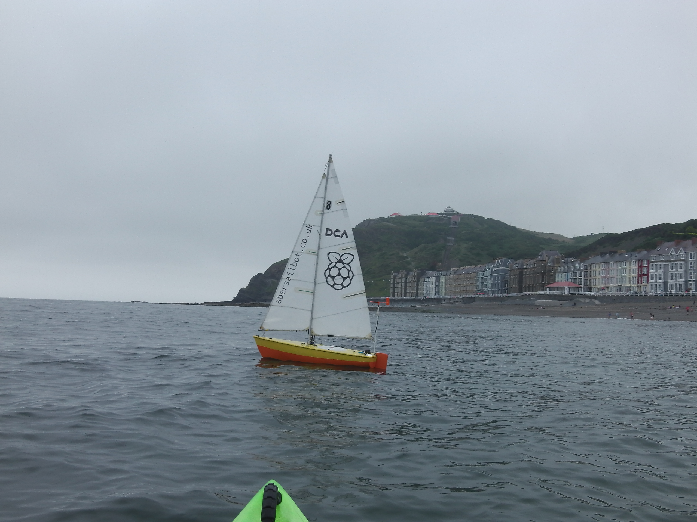

Notes:
---Lizzie---
Introduction

Slide 2
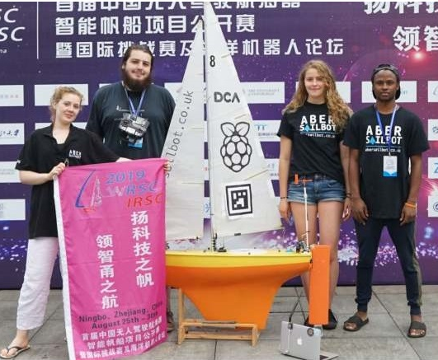
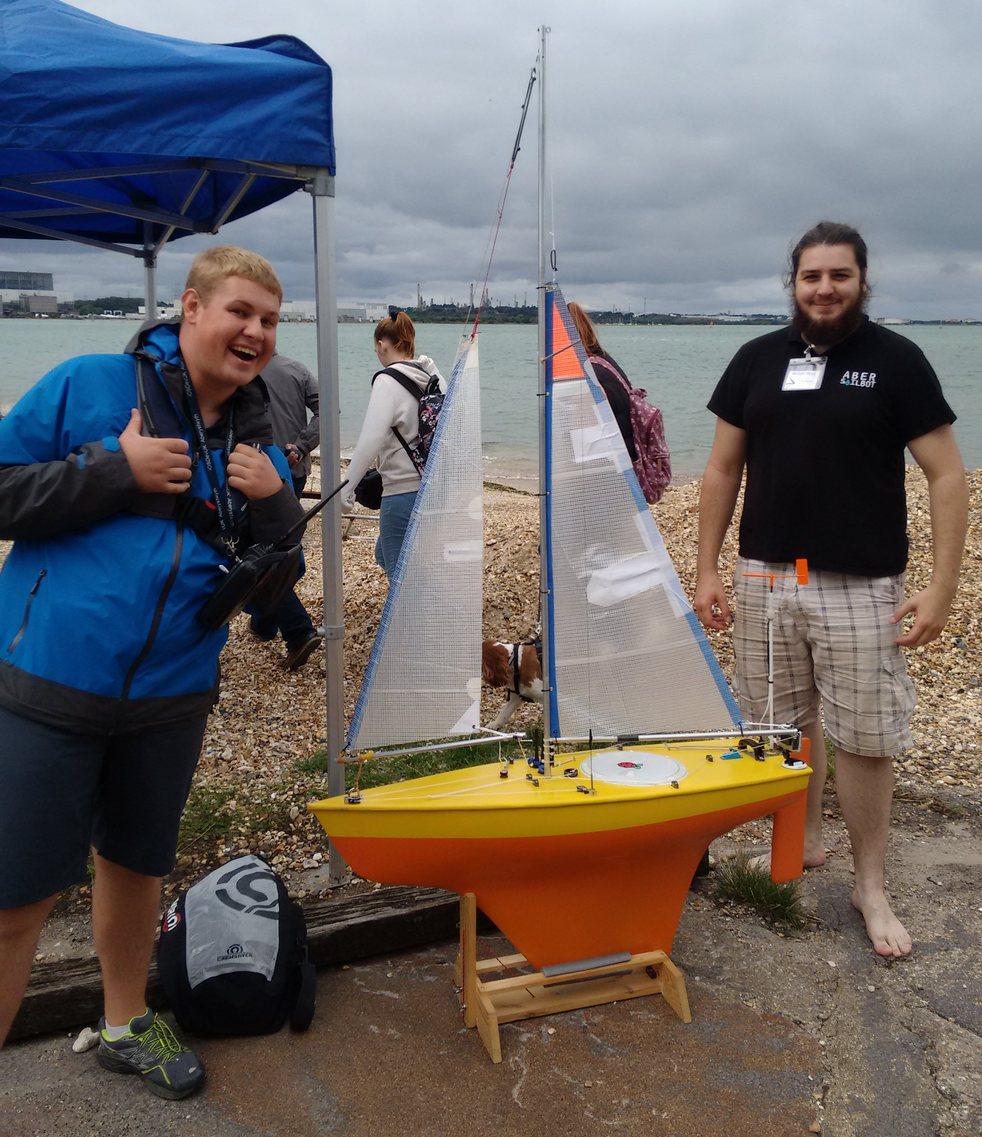
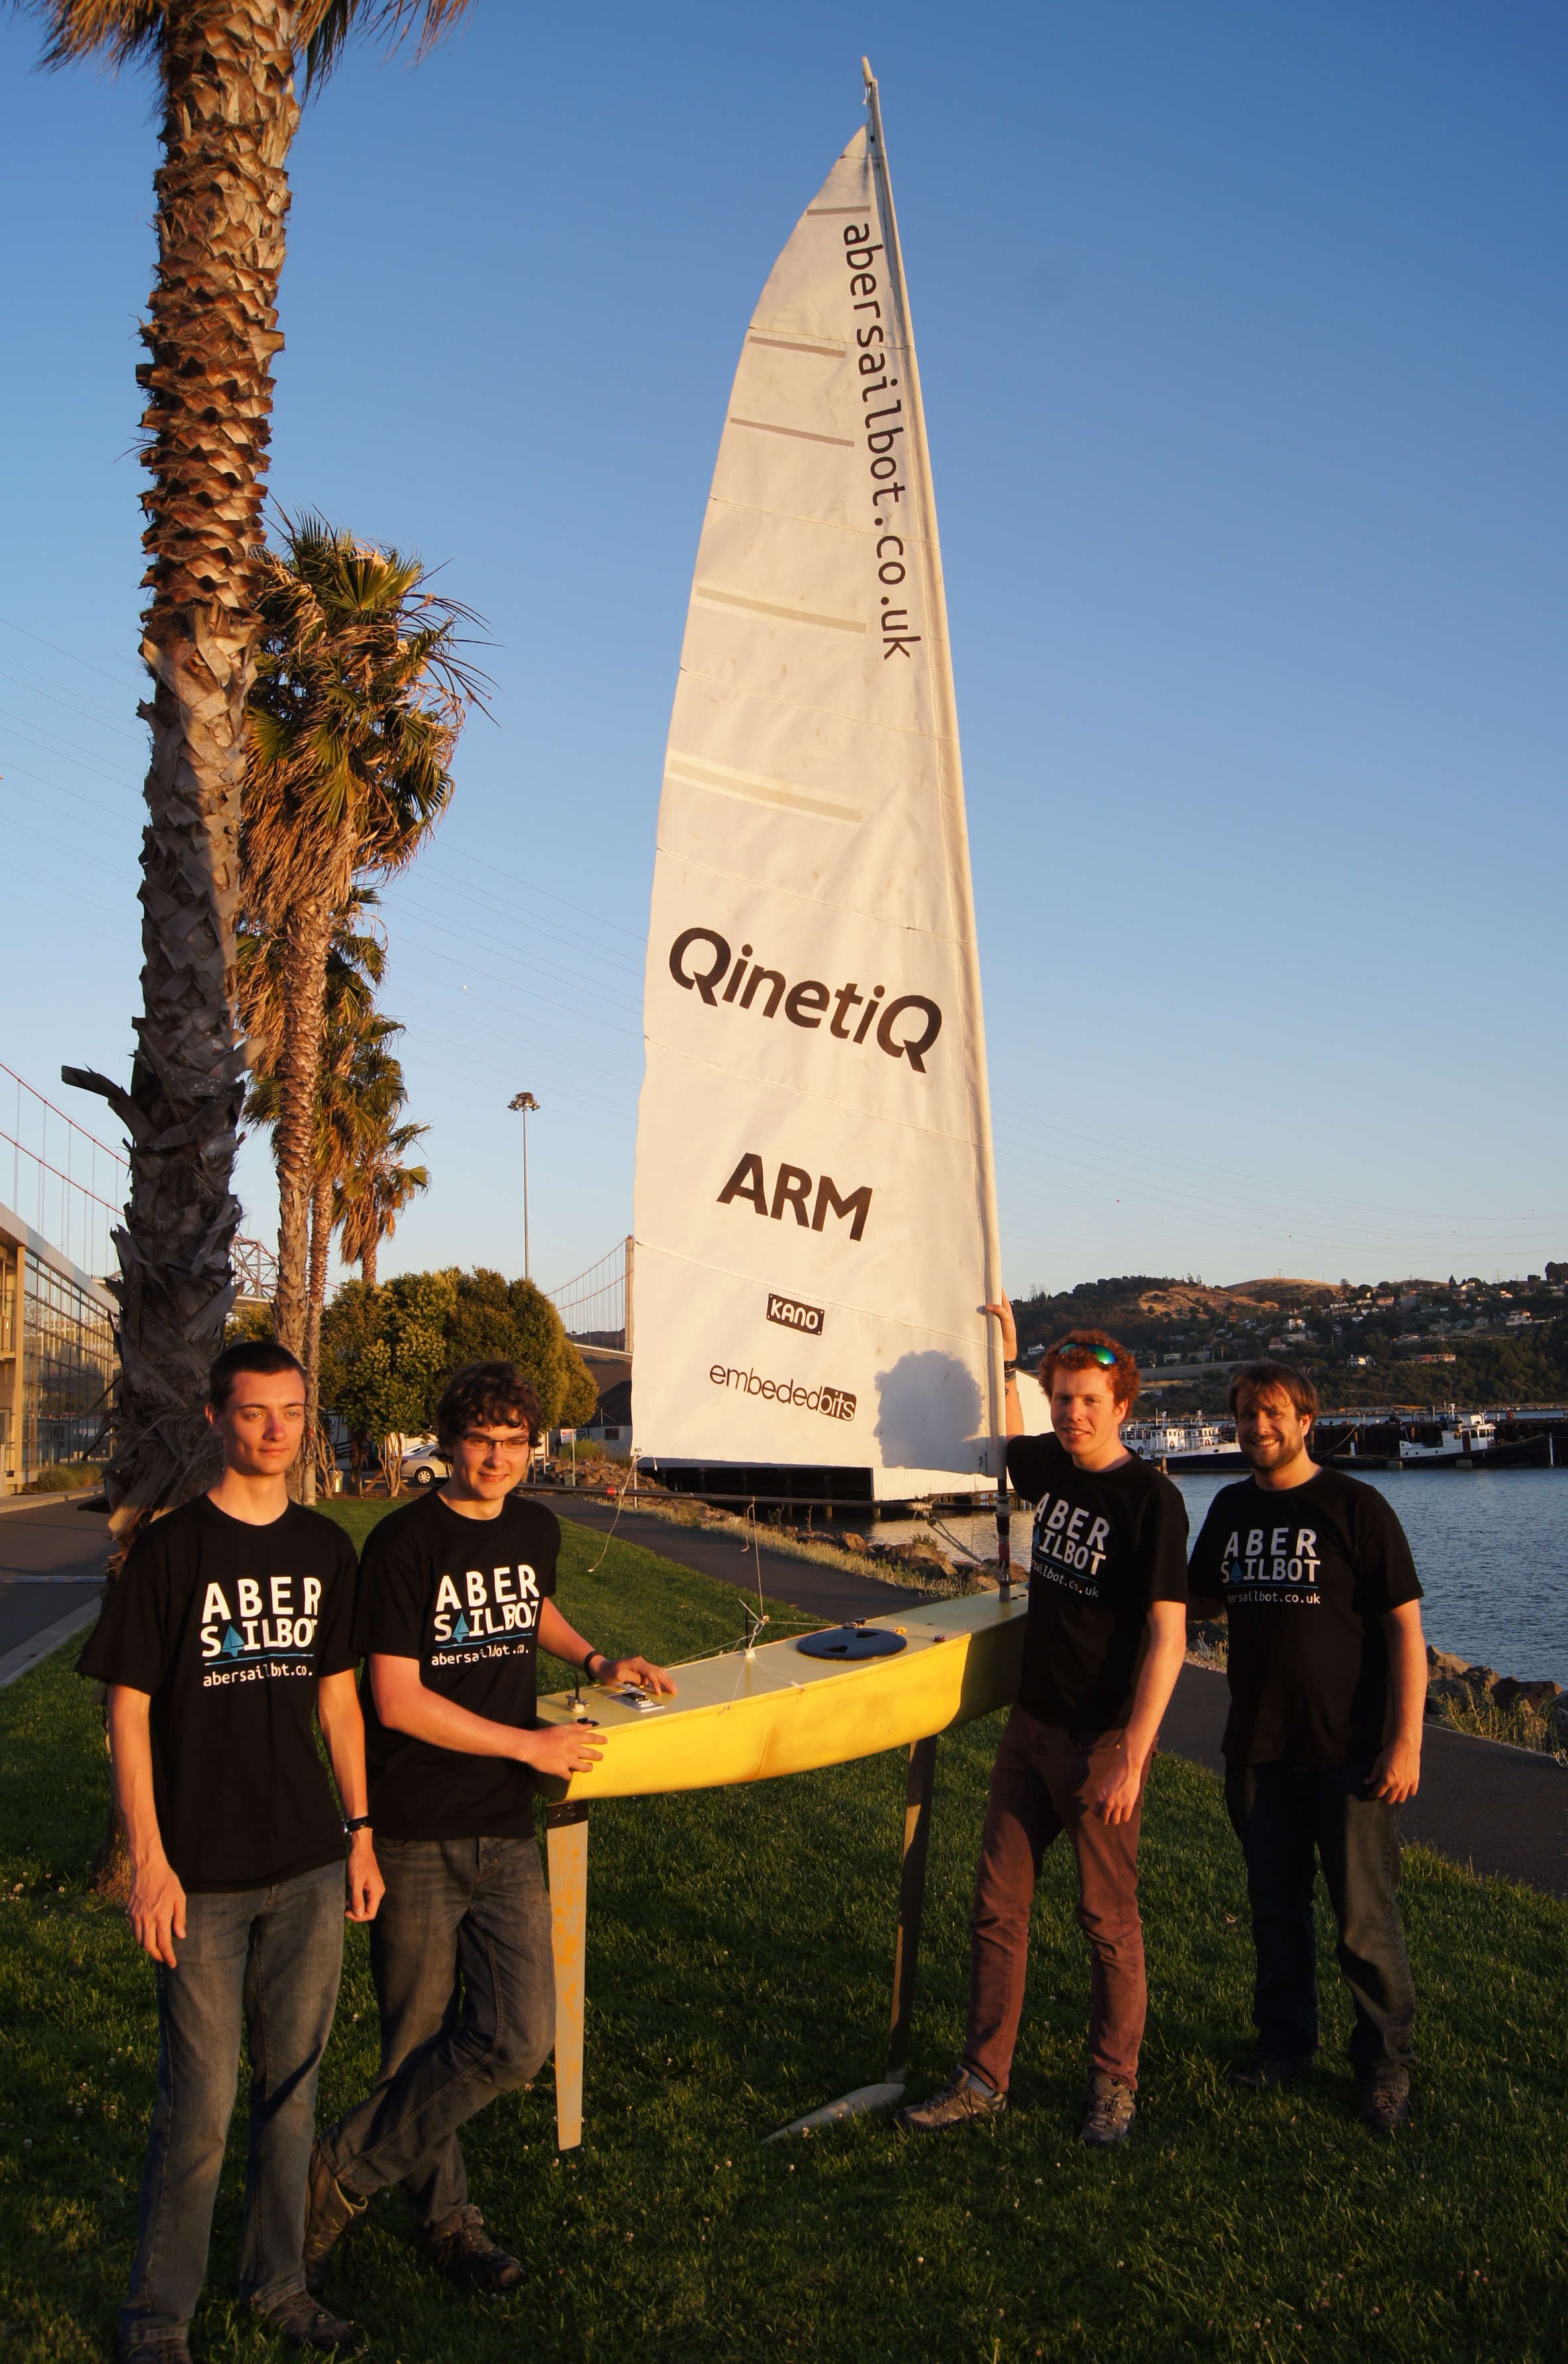



What do we do?
Build Autonomous Robotic Sailing Boats
Write code
Solve the ton of issues that result
Compete around the world
Have fun!
fb.com/abersailbot @abersailbot sailbot@aber.ac.uk
Notes:
Robotic Boats
RC and Sail Themselves
Code (boatd etc)
Competitions
Microtransat
Not alone - community of people

Slide 3
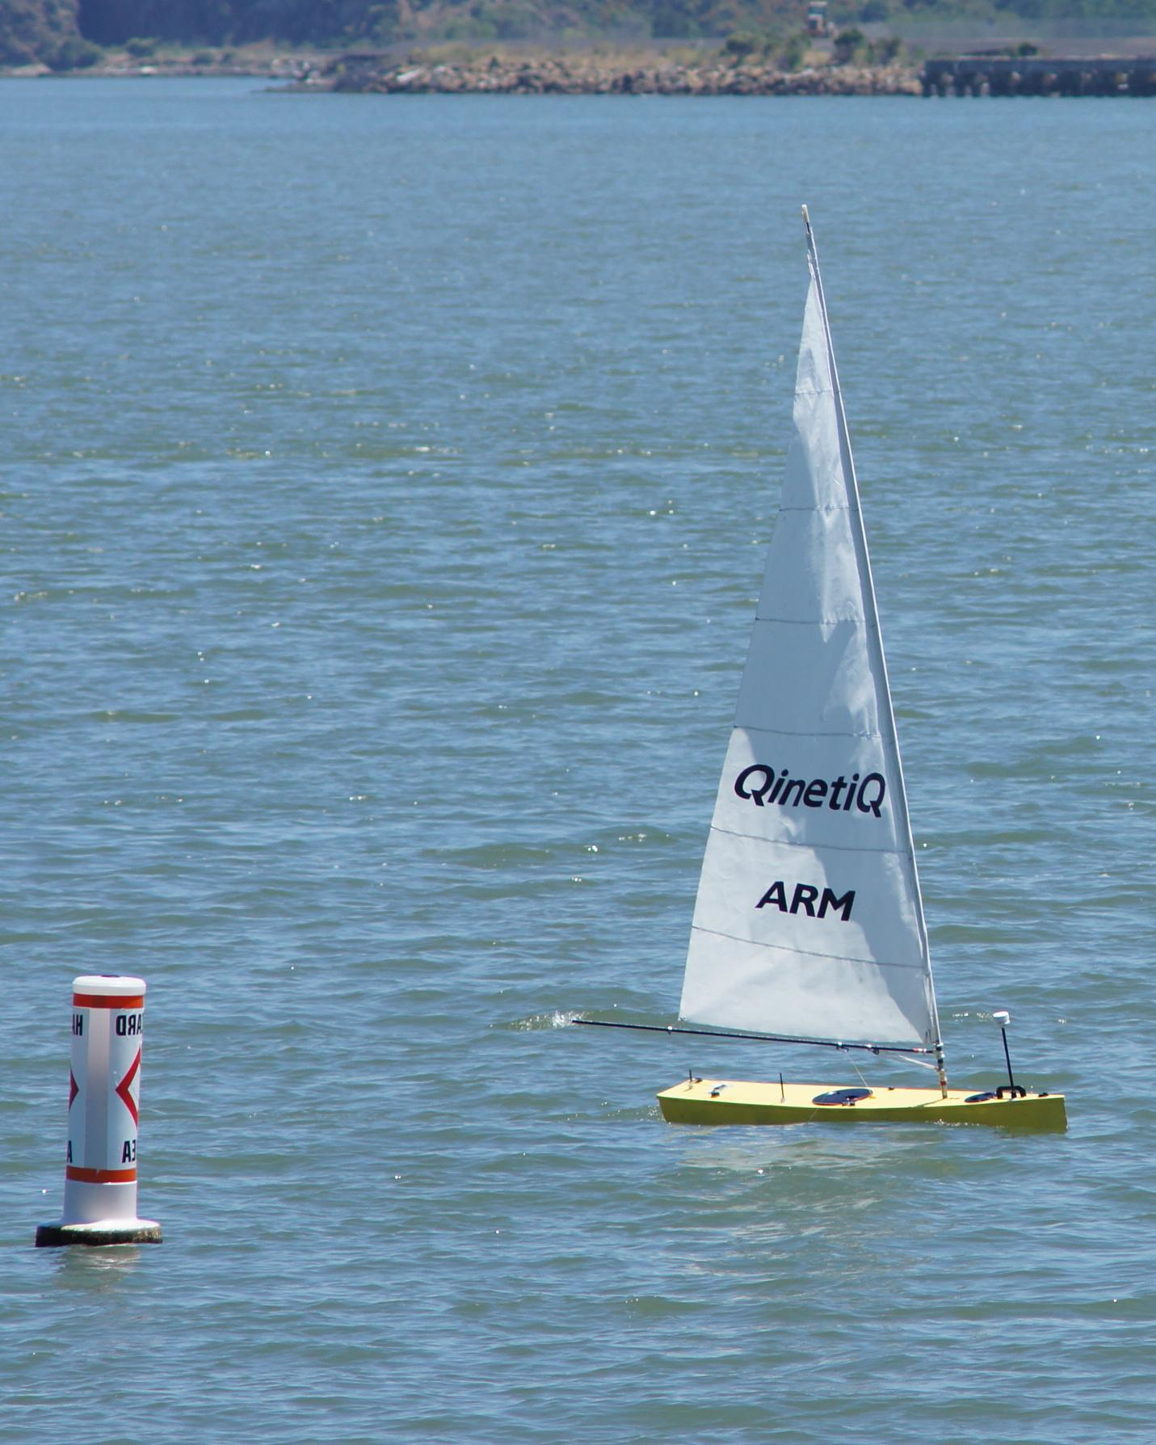
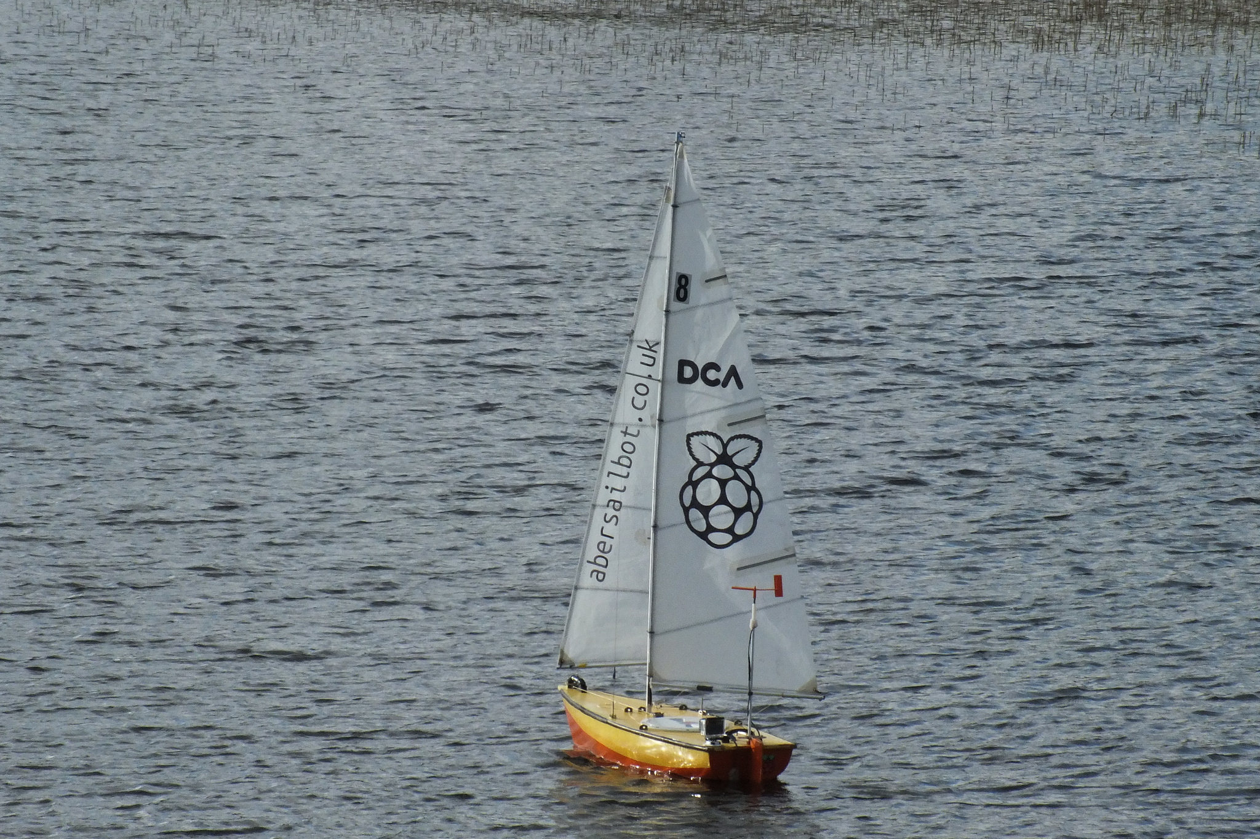
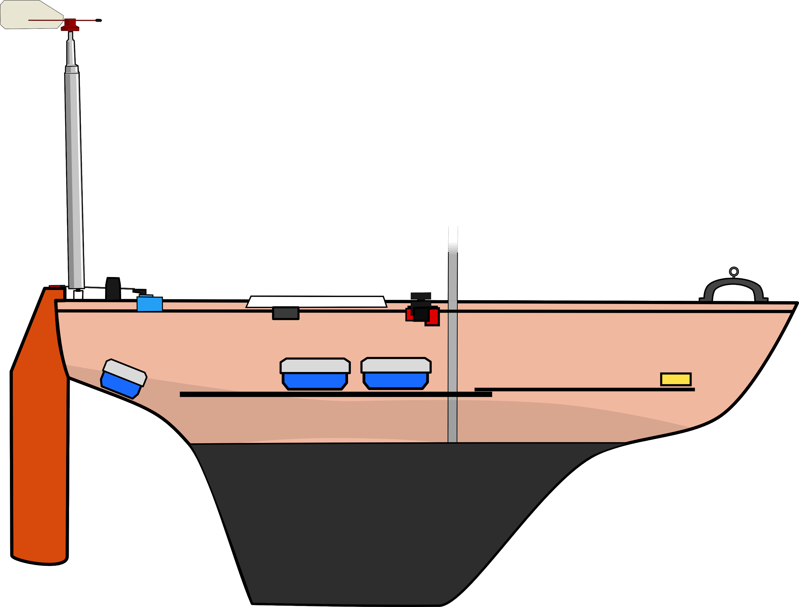
The Boats
Dewi’r Ddraig
Kitty
fb.com/abersailbot @abersailbot sailbot@aber.ac.uk
Notes:
Dewi’r Ddraig
Facts
Main and Jib
Maxi-MOOP hull - Paul Miller
1.2M, not the fastest, strong wind
Stable & reliable
New
Wind Sensor - dept design (rotary encoder)
Handle
Storm Sails
Electronics…
We have a simulator...
Kitty
Still work to be done
Needs new sail
Boat much larger
Detachable keel

Slide 4
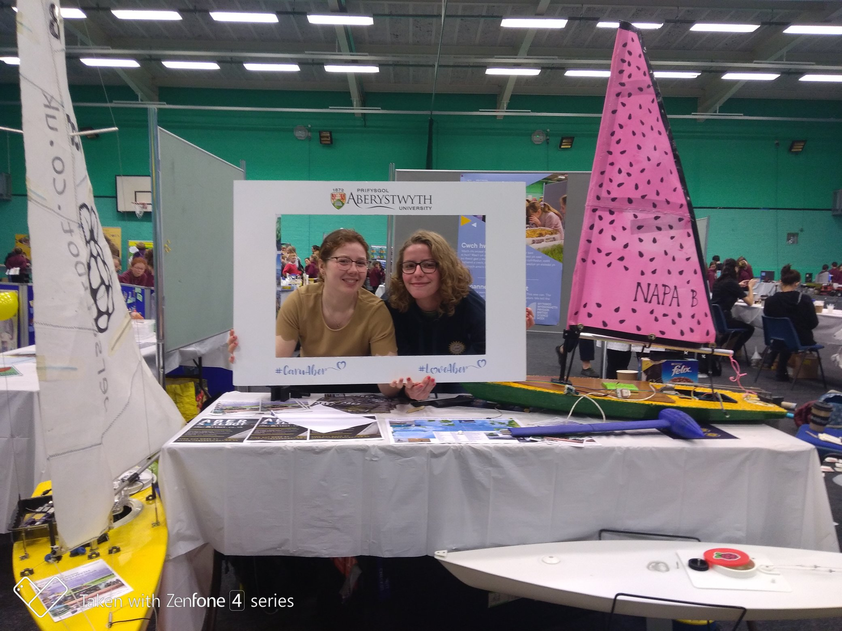
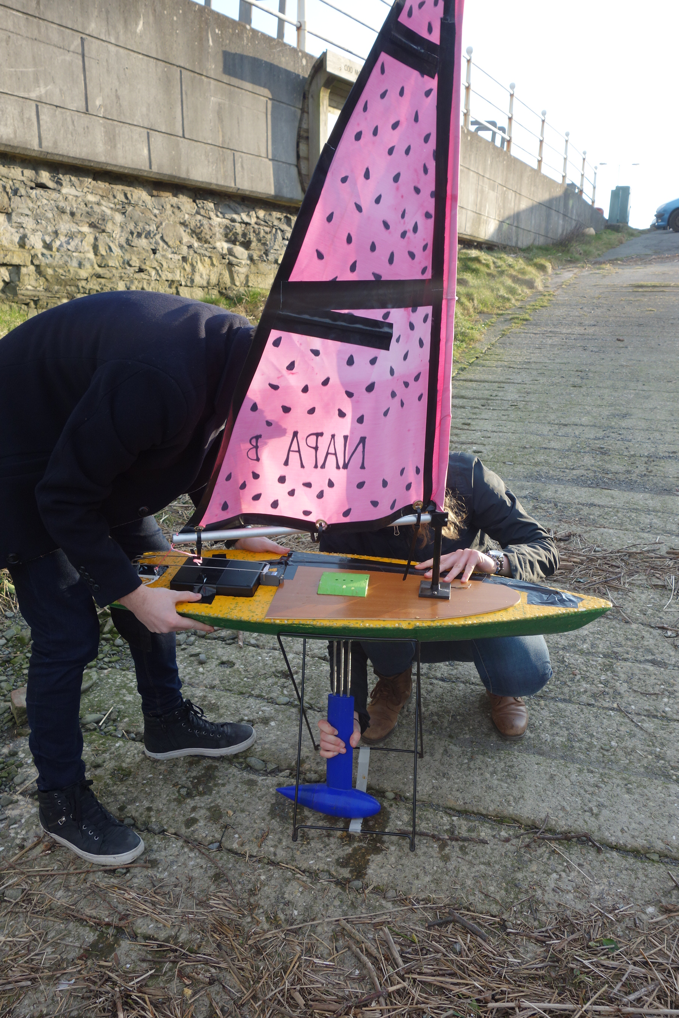
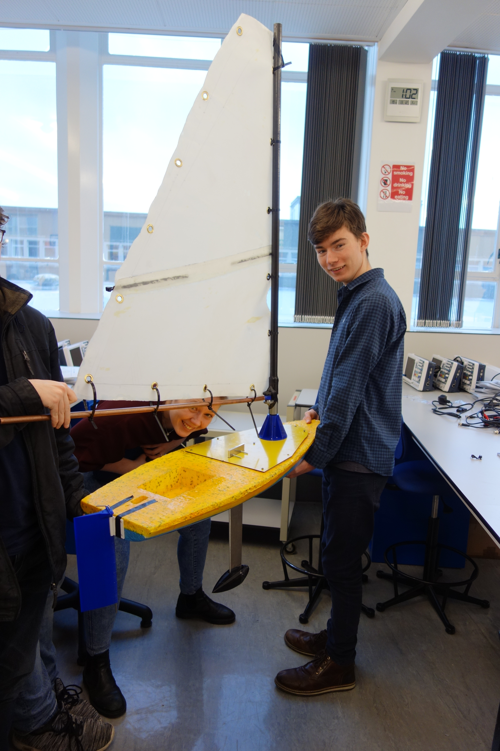
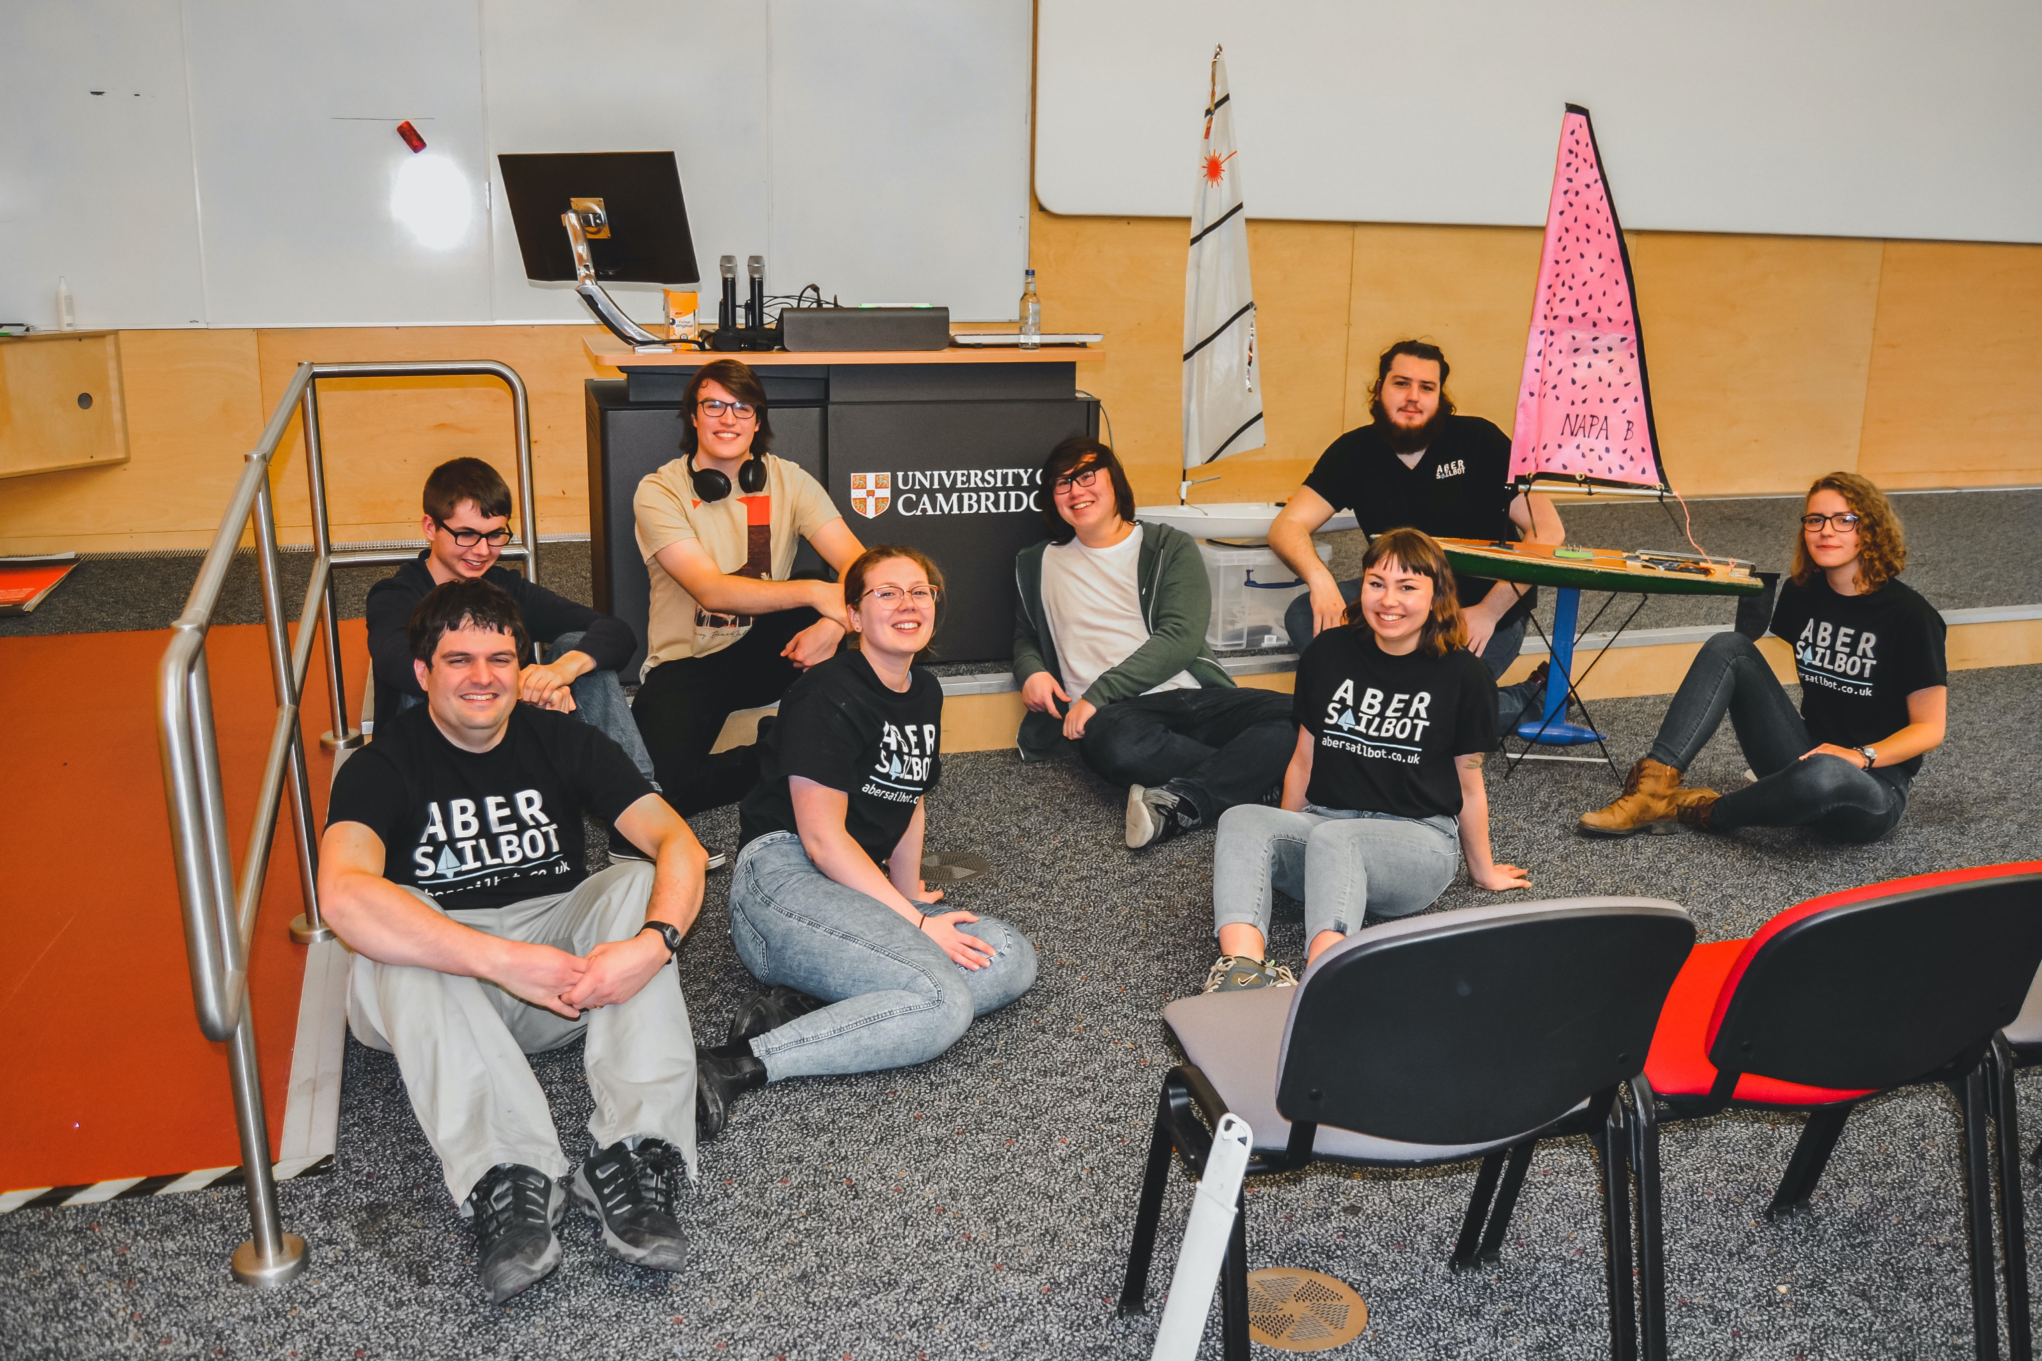
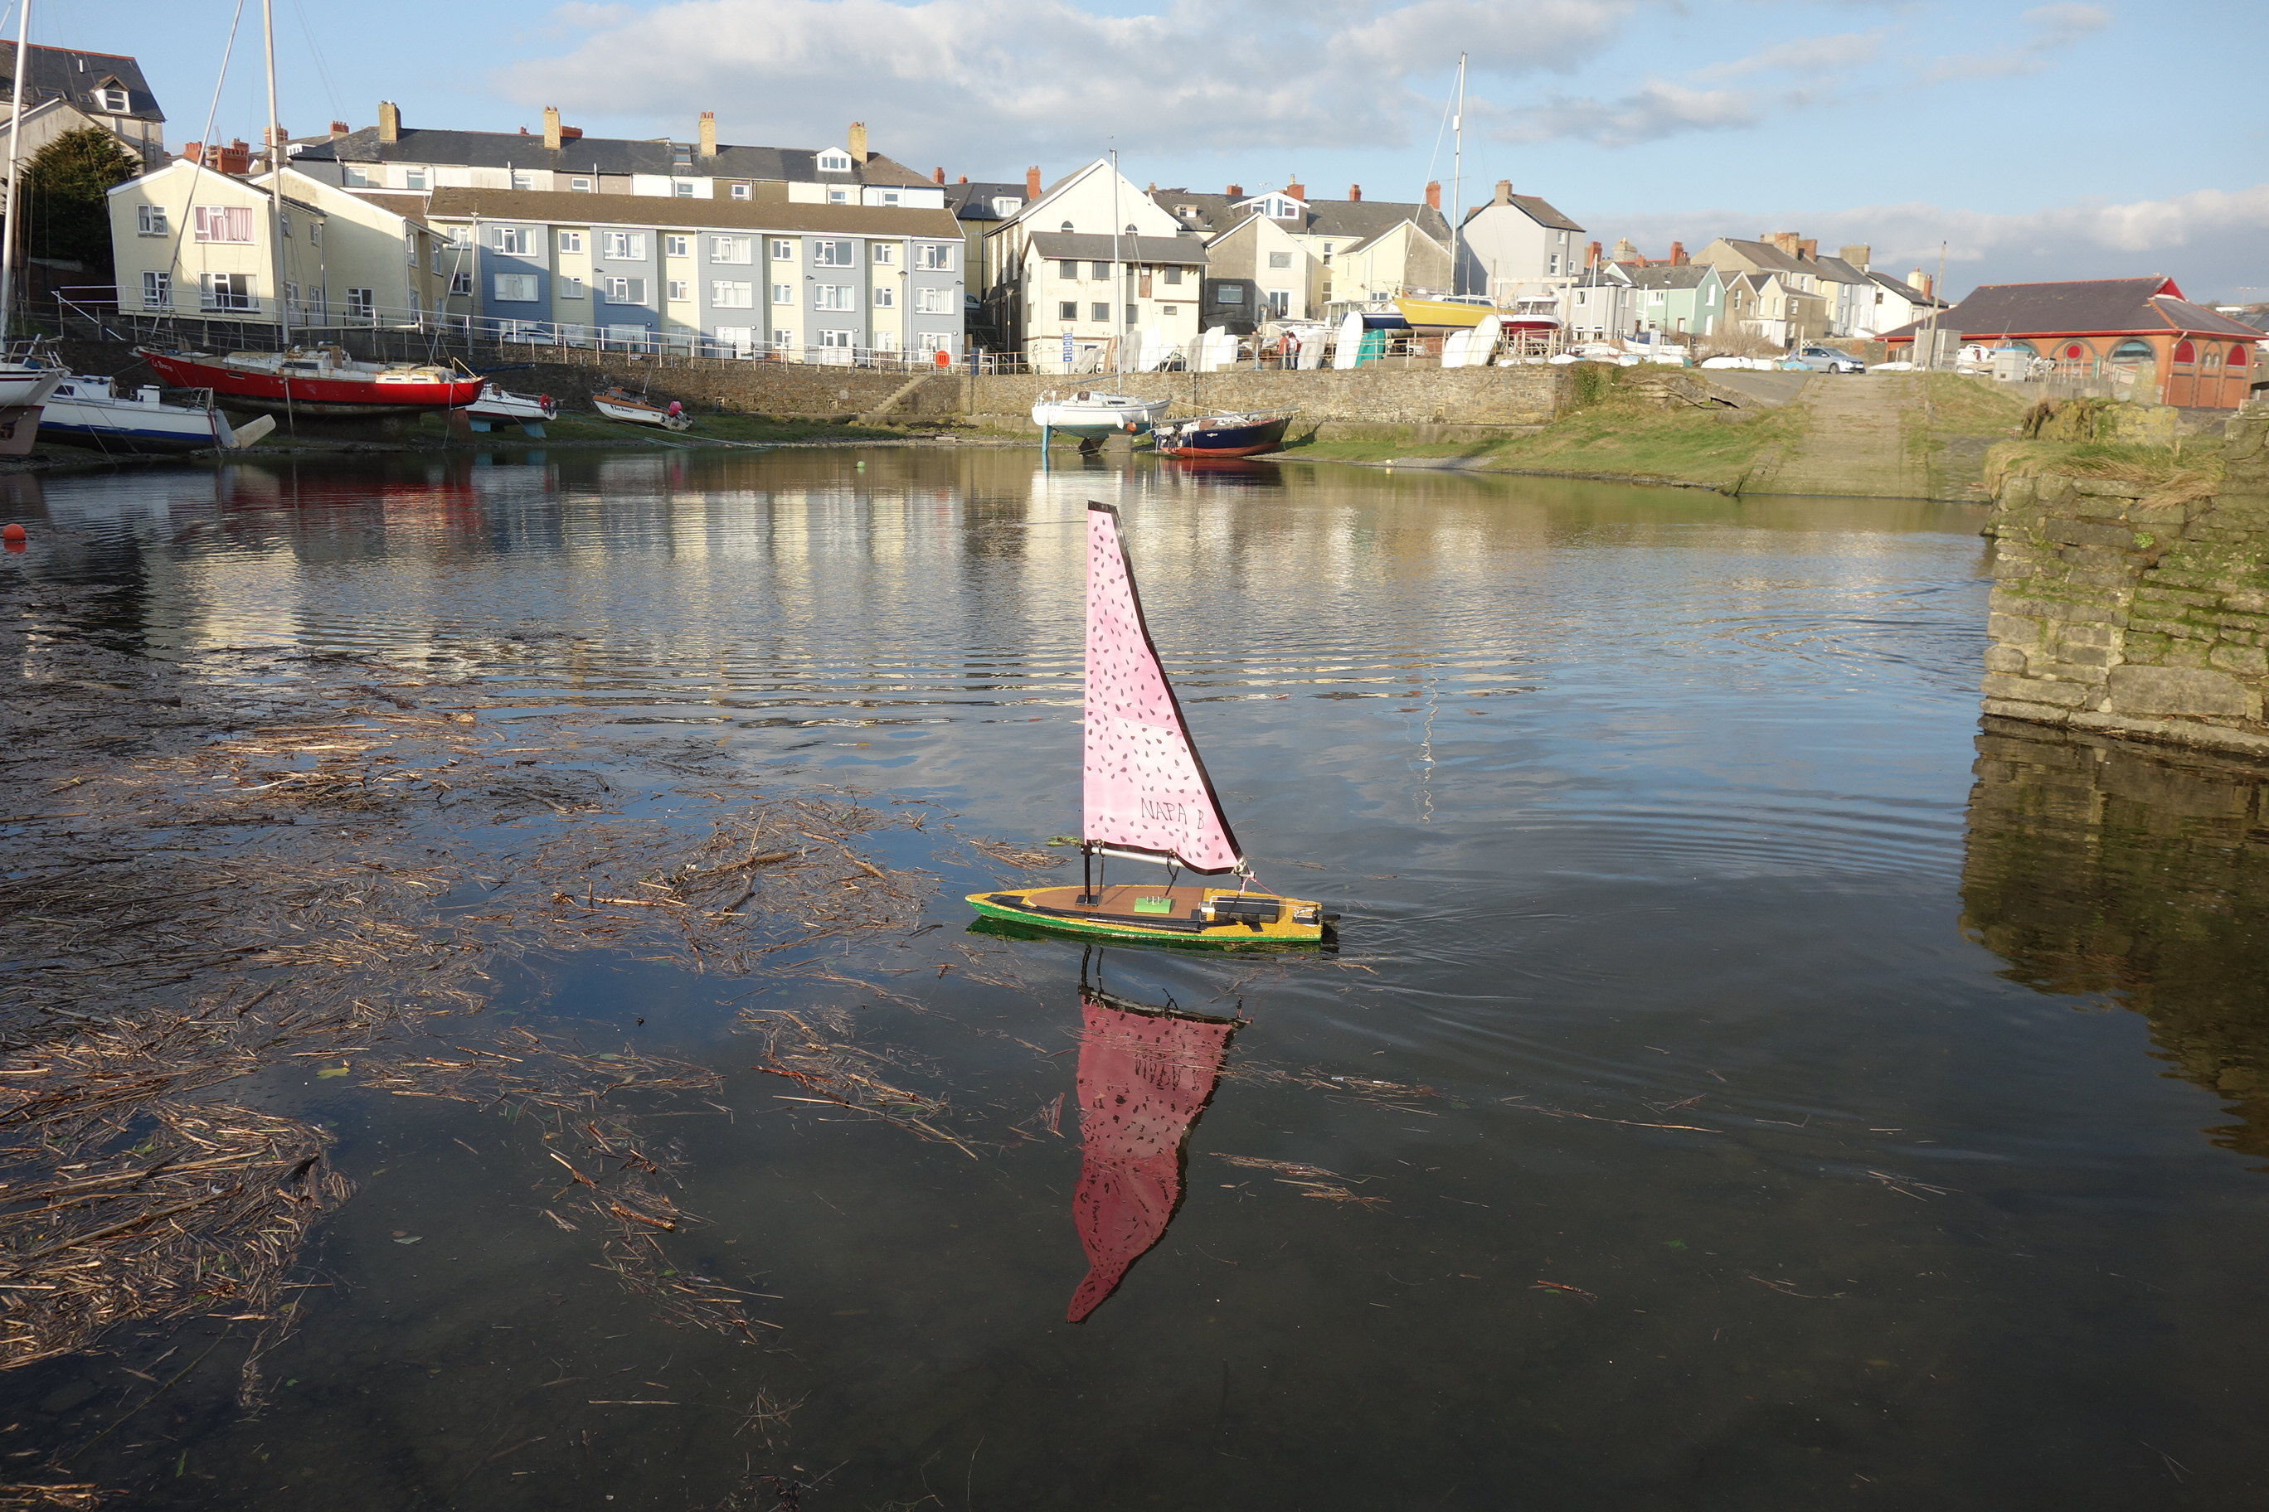
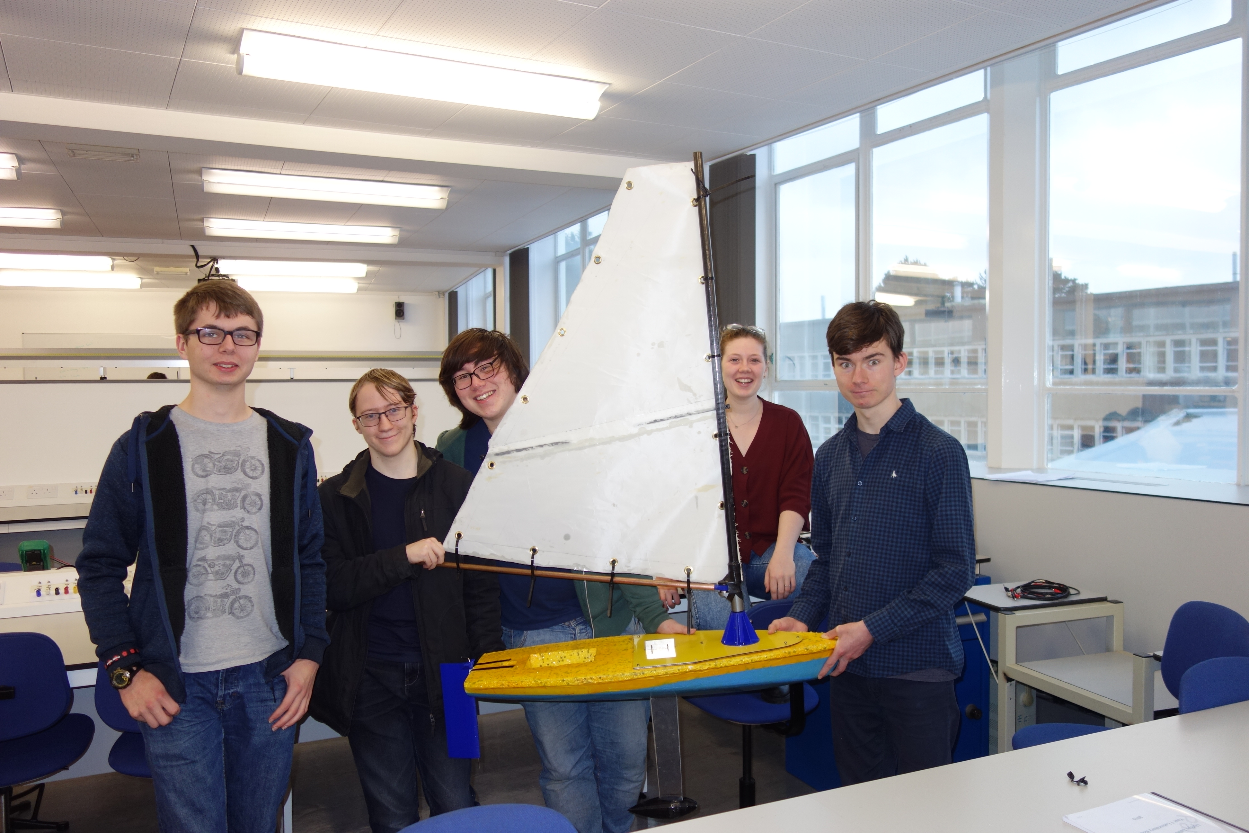
Polystyrene Boats
fb.com/abersailbot @abersailbot sailbot@aber.ac.uk
Notes:
Dewi’r Ddraig
Facts
Main and Jib
Maxi-MOOP hull - Paul Miller
1.2M, not the fastest, strong wind
Stable & reliable
New
Wind Sensor - dept design (rotary encoder)
Handle
Storm Sails
Electronics…
We have a simulator...
Kitty
Still work to be done
Needs new sail
Boat much larger
Detachable keel

Slide 5
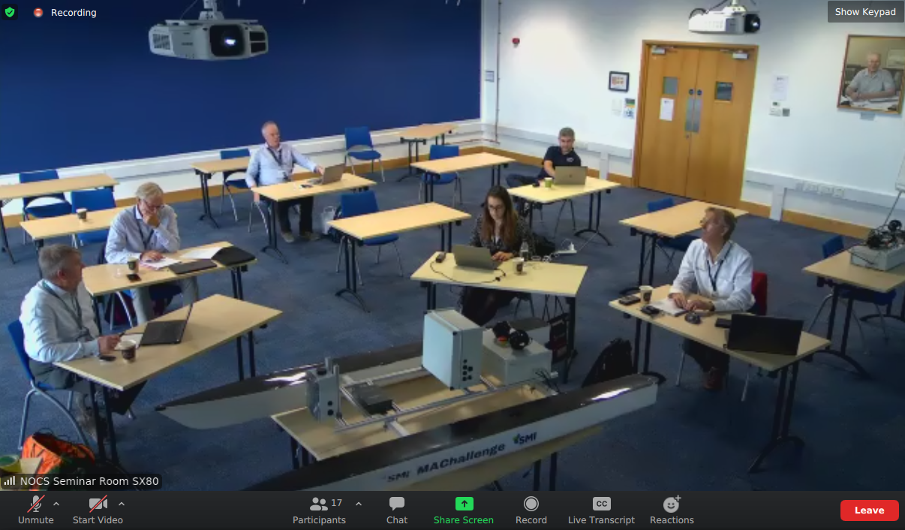
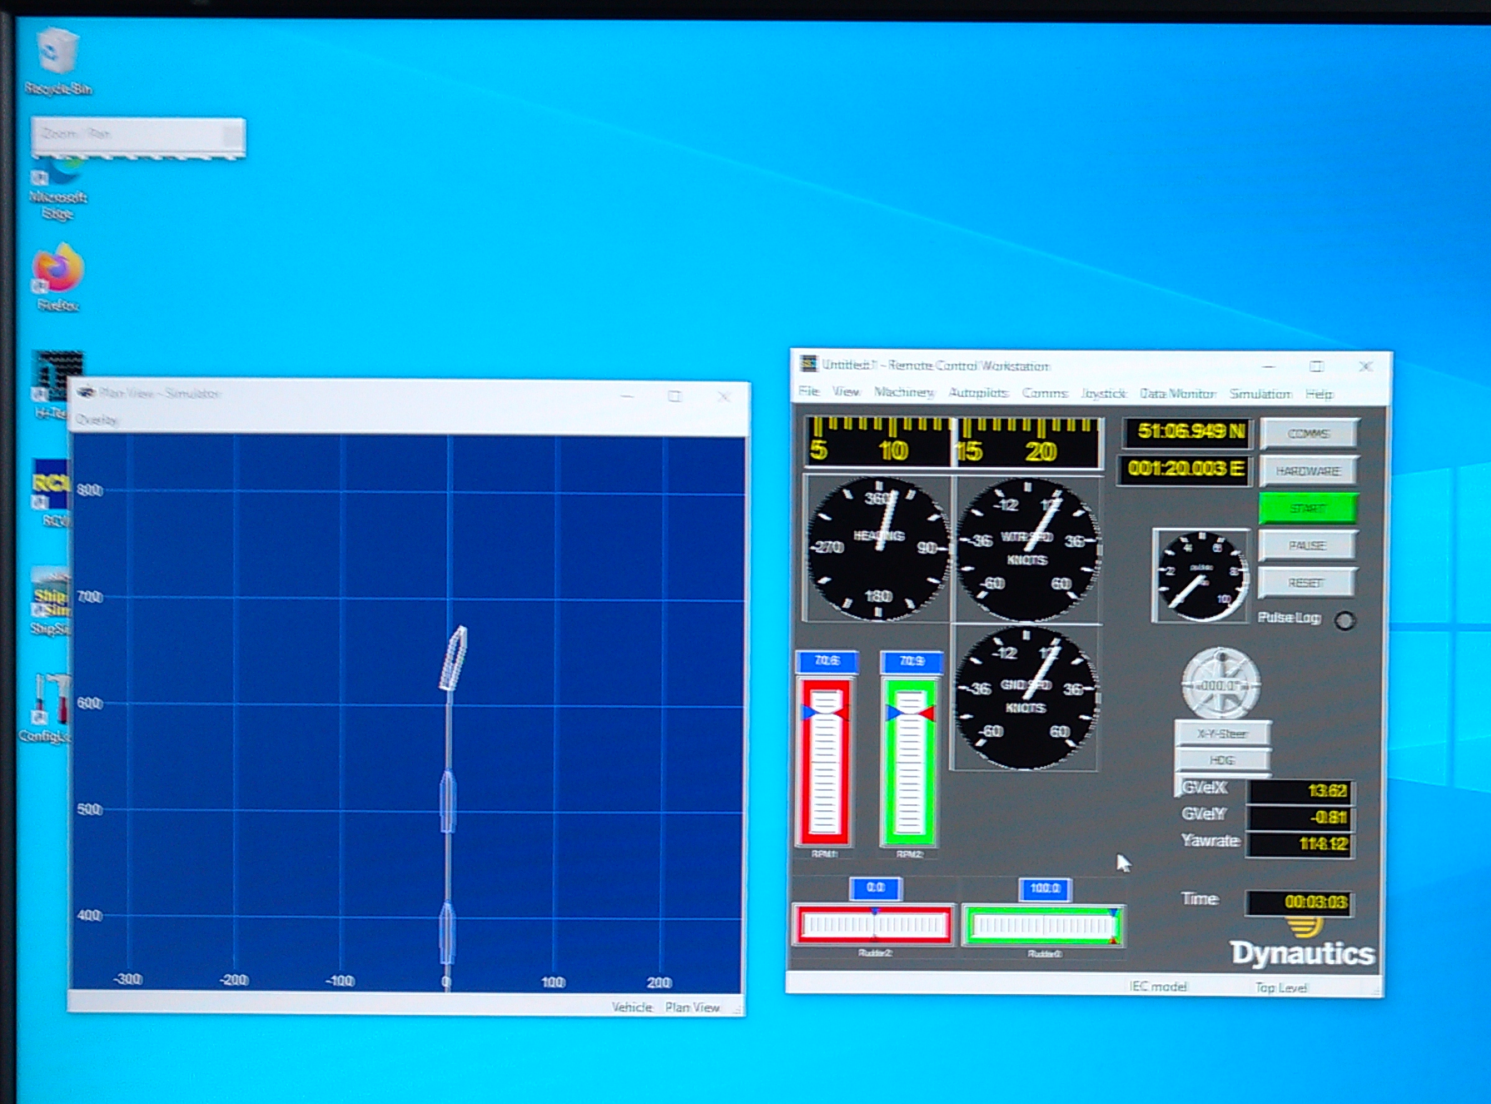
Marine Autonomy Challenge
Industry sponsored competition
Remote access to a boat running our code
Access to commercial grade simulators
fb.com/abersailbot @abersailbot sailbot@aber.ac.uk
Notes:
Dewi’r Ddraig
Facts
Main and Jib
Maxi-MOOP hull - Paul Miller
1.2M, not the fastest, strong wind
Stable & reliable
New
Wind Sensor - dept design (rotary encoder)
Handle
Storm Sails
Electronics…
We have a simulator...
Kitty
Still work to be done
Needs new sail
Boat much larger
Detachable keel

Slide 6
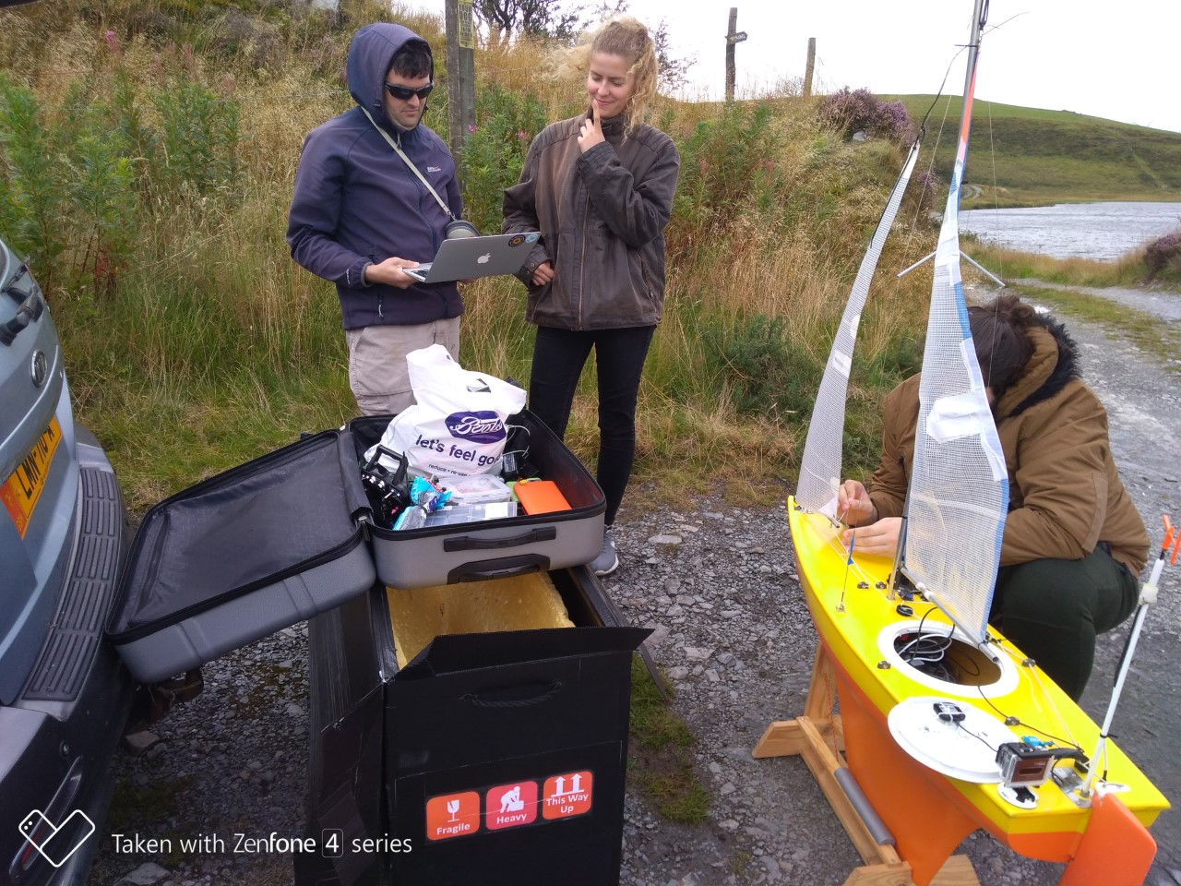
Plan for this year
Marine Autonomy Challenge in November
Finish polystyrene boats and race them
Convert an RC laser to autonomous
Go to a competition (COVID permitting)
Transatlantic/long distance boat?
fb.com/abersailbot @abersailbot sailbot@aber.ac.uk
Notes:
Robotic Boats
RC and Sail Themselves
Code (boatd etc)
Competitions
Microtransat
Not alone - community of people

Slide 7
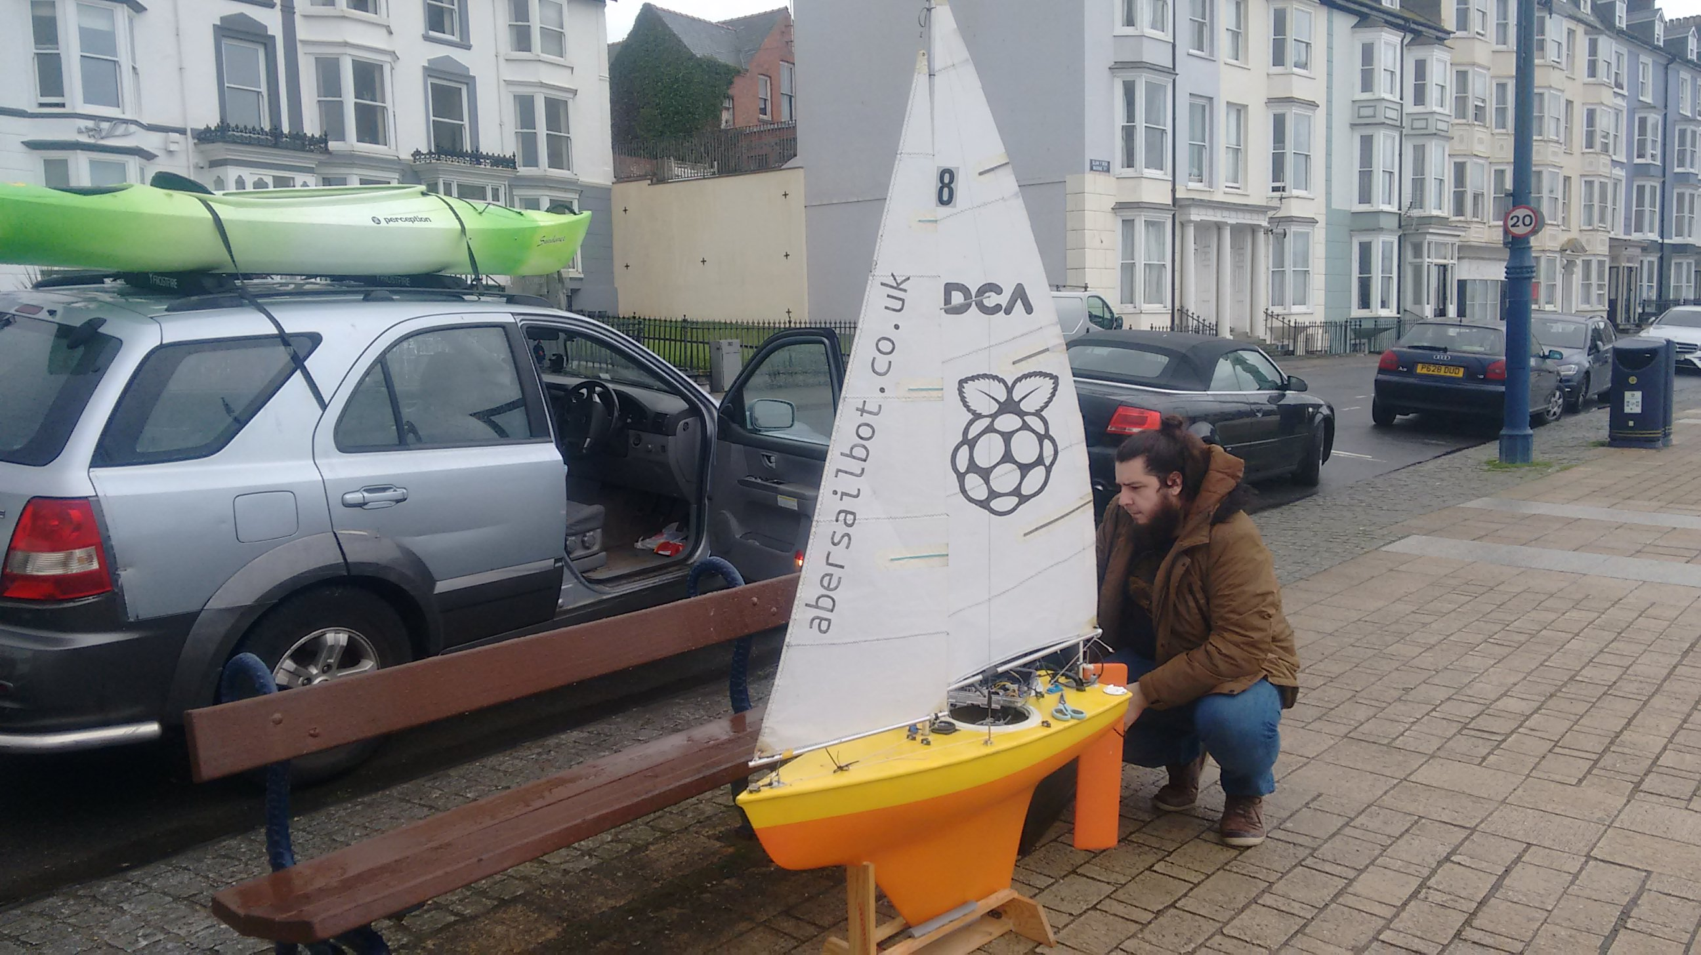
First Meeting
Submit your email address https://abersailbot.co.uk/joinus
We’ll invite you to our Discord server
First meeting online next week.
In person events to follow
fb.com/abersailbot @abersailbot sailbot@aber.ac.uk
Notes:
Robotic Boats
RC and Sail Themselves
Code (boatd etc)
Competitions
Microtransat
Not alone - community of people

Slide 8
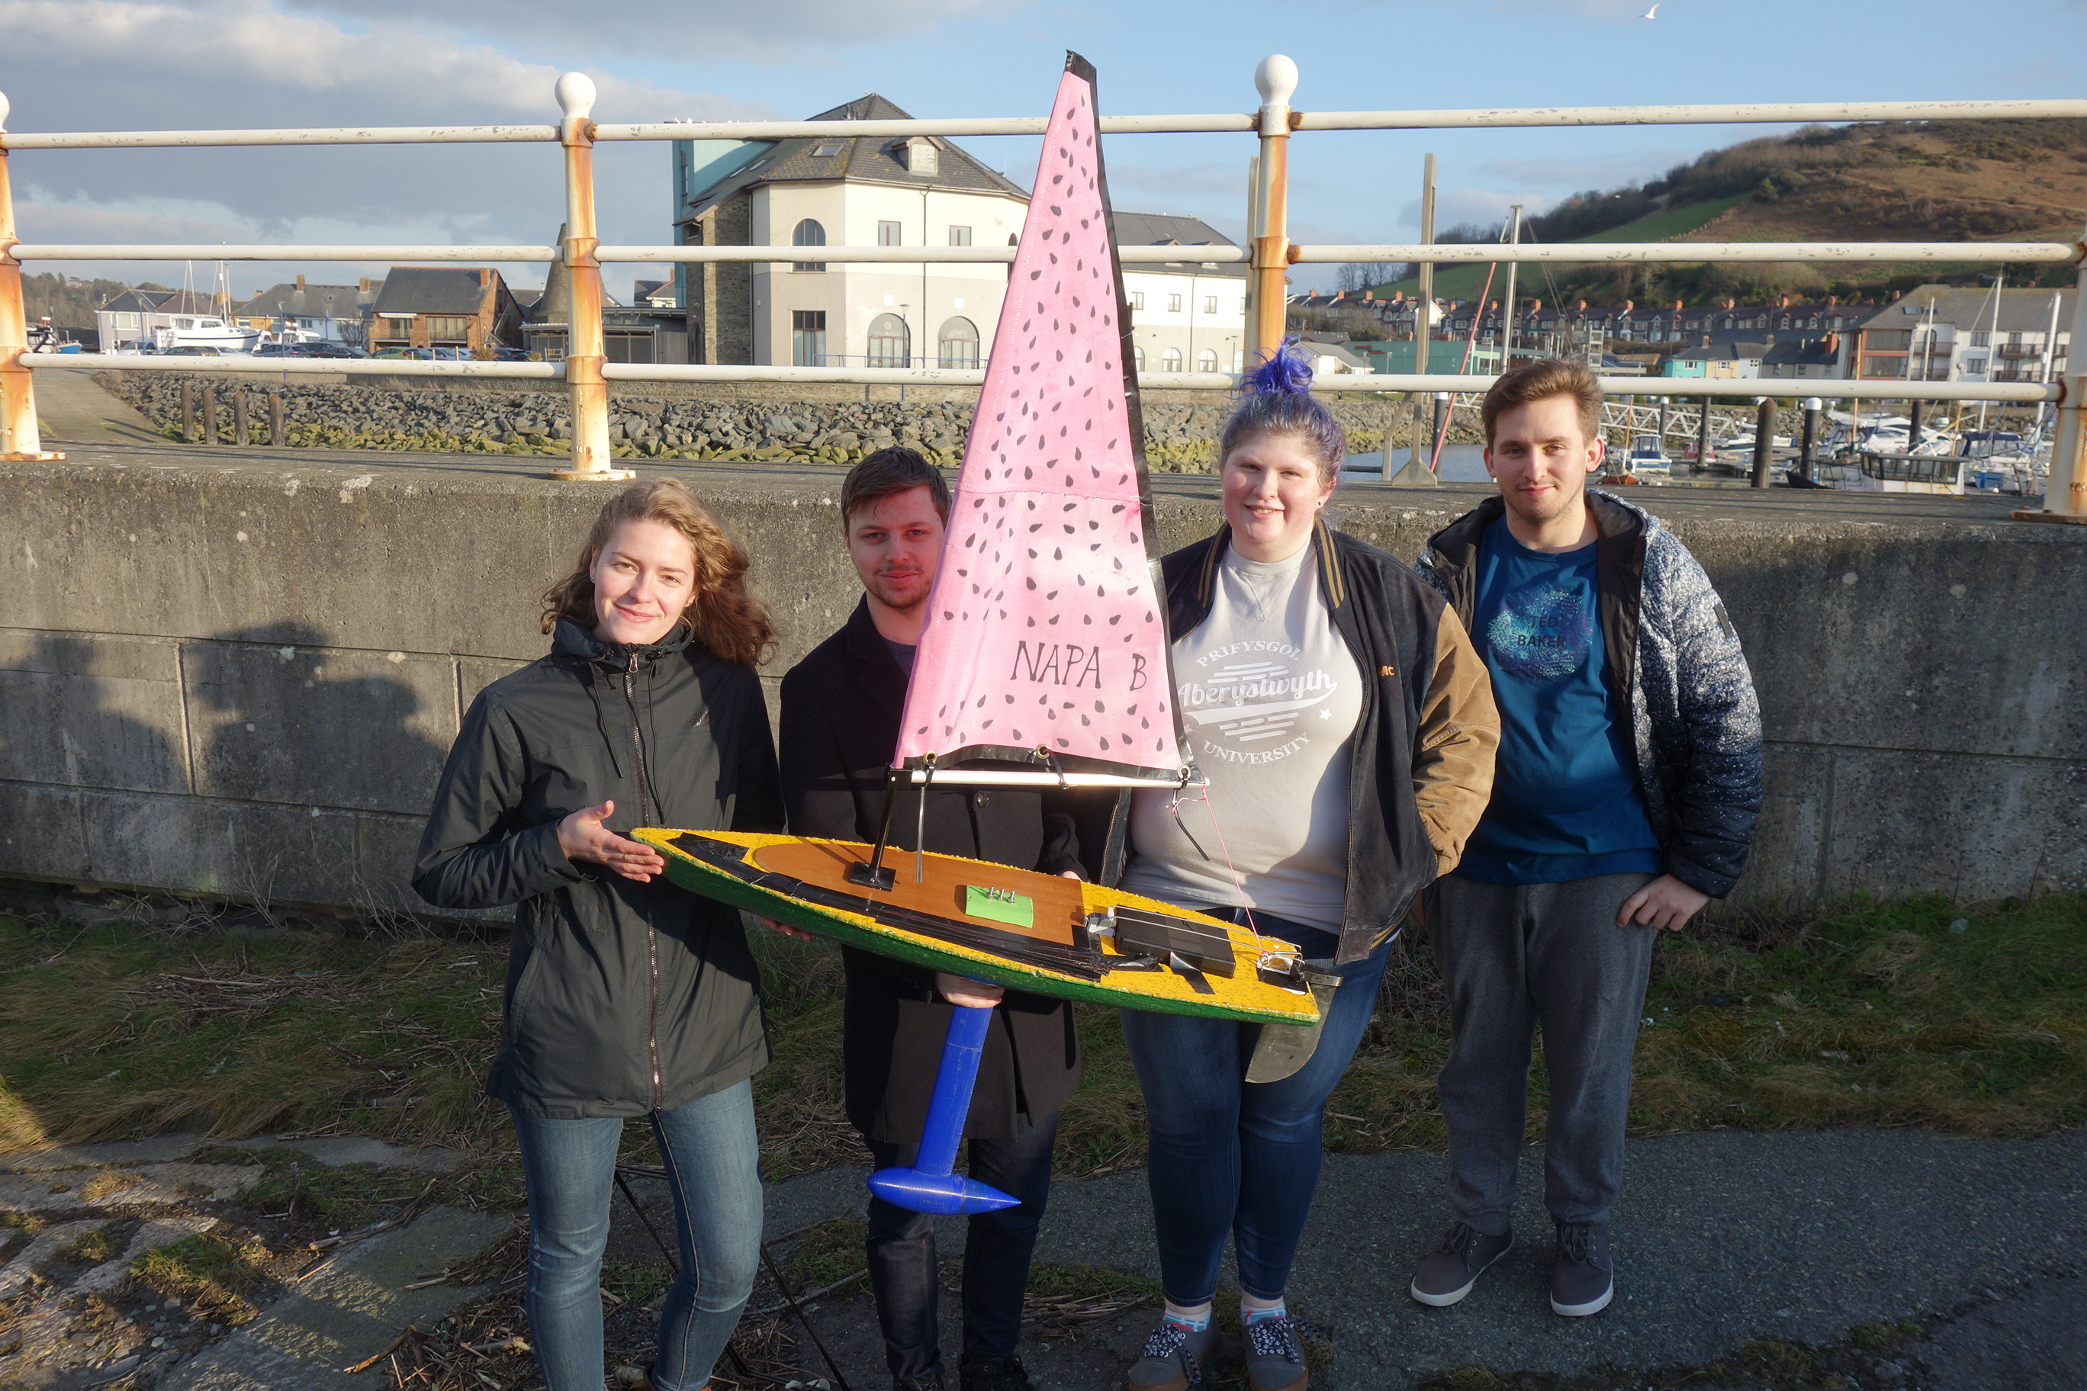
Thanks for Listening!
JOIN US!
abersailbot.co.uk/joinus
fb.com/abersailbot @abersailbot sailbot@aber.ac.uk
Notes:
Fill form (abersailbot.co.uk/joinus)
Give us email in ThinkTank
Facebook Message, Tweet, Email

